Slide 1
FAKE NEWS DETECTION
TS- WEB/CC/AI TRACK CAPSTONE PROJECT
Presented By:
1.G.Ragavi
2.S.Susmitha
3.D.Kowsalya
4.M.Kaviya
Guided By:Mayank shrivastava

Slide 2

OUTLINE
Abstract
Problem Statement (Should not include solution)
Aims , Objective & Proposed System/Solution
System Design
System Development Approach(Technology Used)
Algorithm & Deployment
Conclusion
References
Future Scope

Slide 3
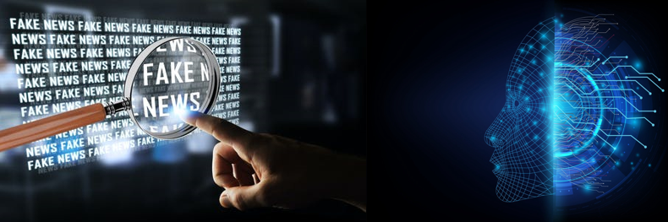
Abstract
Most of the fake news detection system utilize the linguistic feature of the
the news.
However , they have difficulty in sensing highly ambiguous fake news which can be detected only after identifying meaning and latest related information.

Slide 4
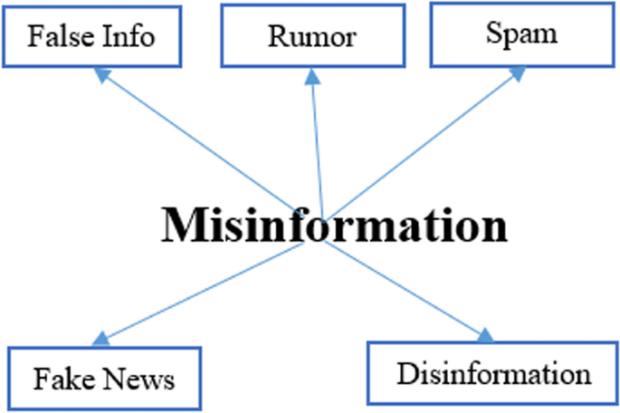
Problem Statement
In this day and age, it is extremely difficult to decide whether the news we come across is real or not. There are very few options to check the authenticity and all of them are sophisticated and not accessible to the average person. There is an acute need for a web-based fact-checking platform that harnesses the power of Machine Learning to provide us with that opportunity.

Slide 5
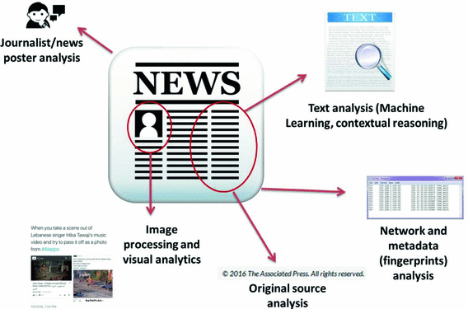
Proposed Solution
If a website has published fake news before, there’s a good chance they’ll do it again . By automatically scraping data about these sites the hope is that our system can help figure out which once are likely to do it in the first place .

Slide 6
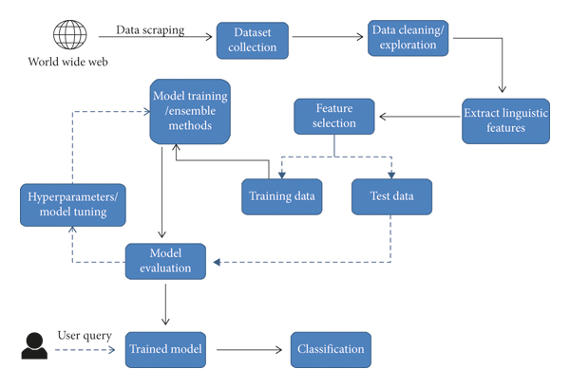
System Architecture

Slide 7
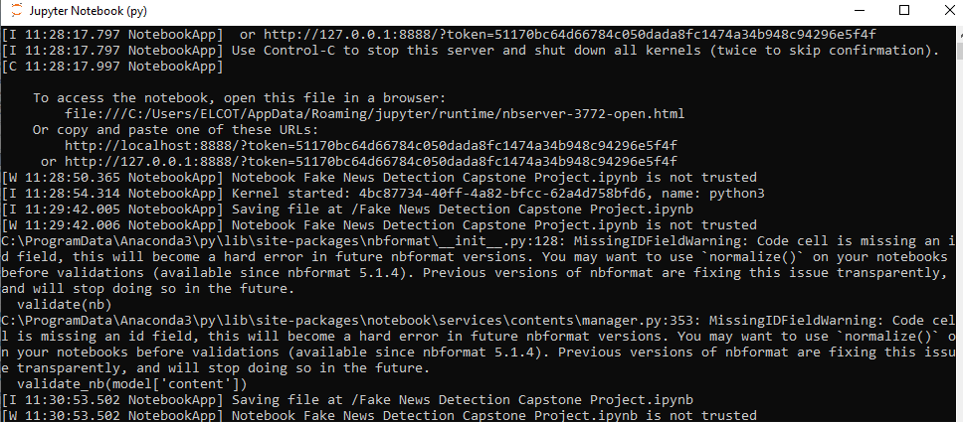
System Deployment Approach
We want to using the OS of windows 10 that the used to easy way of downloading Anaconda in the size of 64 bit.
We have approaced to lanch the jupiter notebook on the working the python coding.
We have downloding all libraries in Anaconda Navigator like pandas,numpy,seaborn,..etc.And then working on the jupiter notebook running on kernal.

Slide 8
Algorithm & Deployment
We have used on the some libraries in python such as:
Pandas
Seaborn
Numpy
Matplotlib
Sklearn
TfidVectorizer
LogisticRegression
DecisionTreeClassifier,Re,string ….etc.

Slide 9
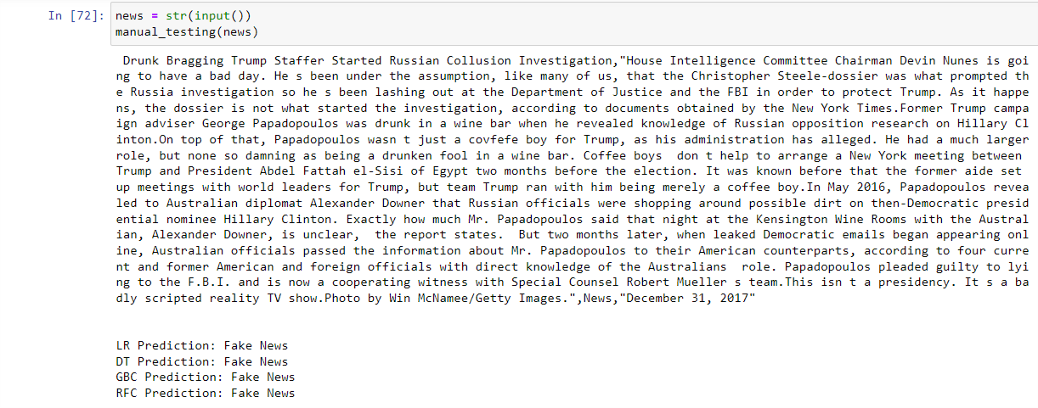
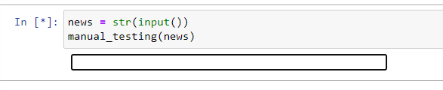
Deployement: we can use the it give below diagrams that first diagram is we find the news copy and paste the search bar and the second diagram is gievn the answer in the fake or true news.

Slide 10
Conclusion
The rise of fake news has become a global problem that even major tech companies like Facebook and Google are struggling to solve.
It can be difficult to determine whether a text is factual without additional context and human judgement .

Slide 11
REFERENCES
1.http://www.anaconda.com/
2.http://en. Wikipedia.org/wiki/Anaconda (python _distribution)
3.http://numpy.org/
4.http://www.oreily.com/data/the-new-artificial-inteligence-market.csp
5.http://seaborn.pydata.org/
6.http://www.kaggle.com/
7.http://pandas.pydata.org/
8.http://matplotlib.org/
9.http://scikit-learn.org/
10.Link for data set;-https://www.simlilearn.com/learn-mac…
11. You tube channel:- https://bit.zVT4WtH

Slide 12
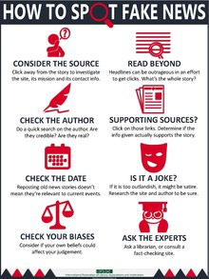
Future Scope
The unfactual knowledge it conveys, its style of writing or content-based, its propagation patterns or social, and the credibility of its source.

Slide 13
THANK YOU

